Slide 1
Recommendation system

Slide 2
Information filtering
This topic has become attractive since 1990
Motivated by the demand of personalization on-line information service
E.g. news filtering, movie recommendation system
It also aims to help people find desired information items
Unlike information retrieval it focuses on users long term and stable information need
It mostly operates on a dynamically changing information streams
Users profile is learnt based on users previously expressed opinions on example items

Slide 3
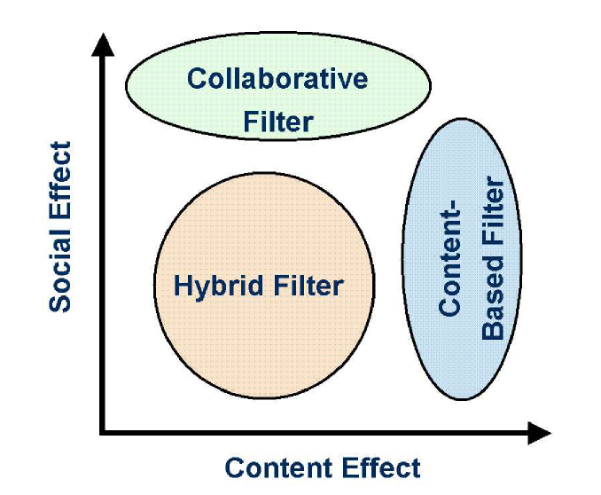
Information filtering approaches
Content effect – items interestingness to a user is determined by examining the items content
Social effect – Examining is done by taking advices from others who have similar profiles with this user

Slide 4
Content based information filtering
It analyzes an items content and predicts its relevance based on the users profile
In this paradigm, each user is assumed to operate independently and thus the social effect is completely ignored
This approach is analog to the relevance feedback in information retrieval
E.g. Rocchio’s algorithm
This adapts the query vector by iteratively absorving a users relevance judgement on newly returned documents
In formation filtering the tuned query vector is actually a profile model
It specified the keywords as well as their relative importance

Slide 5
Relevance feedback
The user issues a (short, simple) query
The search engine returns a set of documents
User marks some docs as relevant (possibly some as non-revant)
Search engines computes a new representation
Runs the new query and returns results
New results have hopefully better precision and recall

Slide 6
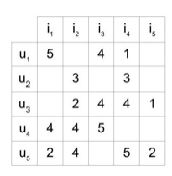
Collaborative filtering
It is a technique that can filter out items that a user might like in the basis of reactions by similar users
It works by searching a large group of people and finding a smaller set of users with similar choice
Consider the below user-item matrix
Note that the matrix is sparse

Slide 7
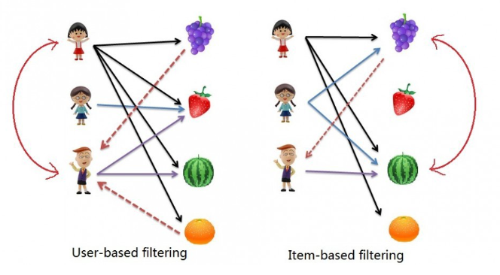
CF - types
Two major types
Memory based
Model based
Memory based
Item – item CF : Users who liked this item also liked ..
User – item CF : Users who are similar to you also liked ..

Slide 8
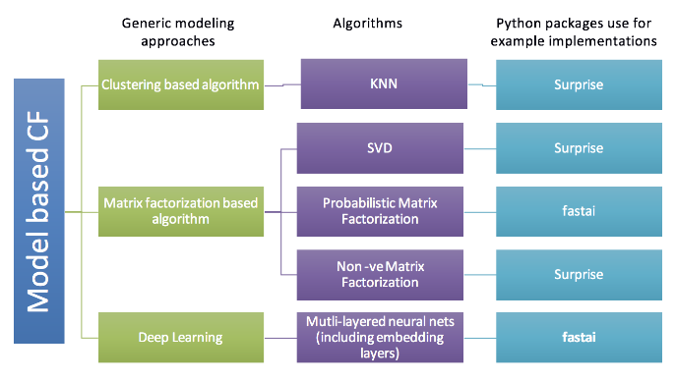
Contd..
Model based
Few good public dataset available
Movie lens dataset is quite well known
ml-20m
ml-1m

Slide 9
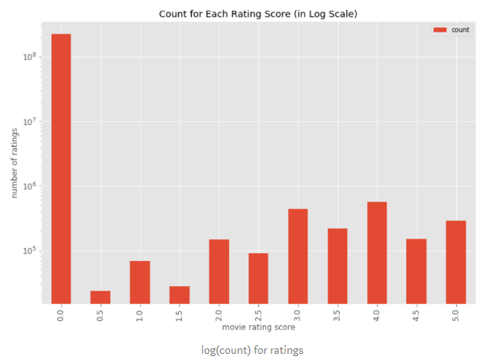
Contd..
Generally these dataset is very sparse
Users no of rating threshold – User should rate # of movies >= threshold (e.g. 50 out of 13,567)
Movies no of rating threshold – A movie should be rated # times >= threshold (e.g. 50 out of 13,567)

Slide 10
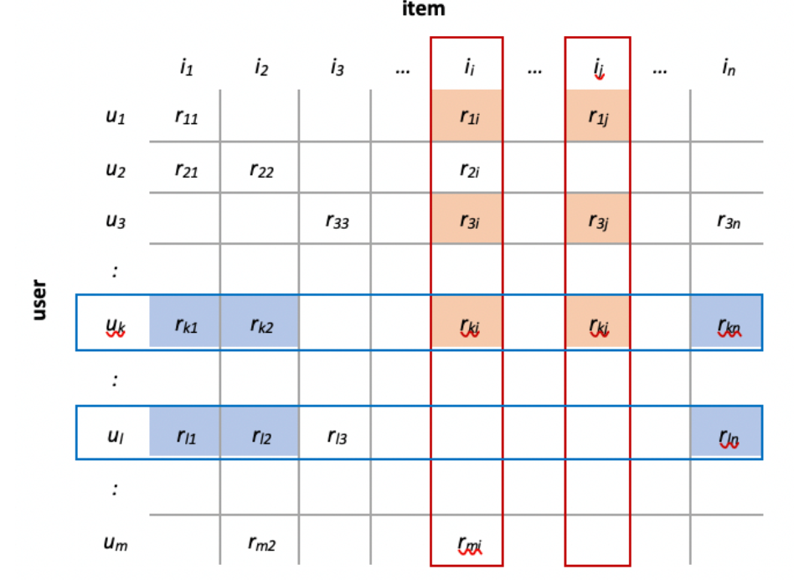
Memory based approach
The following figure illustrates the two filtering methods in the user-item rating matrix. For user-based filtering, the similarity between user u_{k}and user u_{l}is calculated by averaging similarities between ratings in columns i₂,i₃and i_{n}. This process is iterated to compare all users. For item-based filtering, the similarity between item i_{i}and item i_{j}is measured by calculating similarities between ratings in rows u₁,u₂and u_{k}.
Similarities are commonly measured by “Pearson correlation” or “vector cosine”. The first method computes the linear correlation between two user ratings (or item ratings) and validates how much those two users (or items) vary from each other. The second method, as explained in our previous blog, treats two users (or items) as multi-dimensional vectors and compares the angle between them by taking the cosine value.
Memory-based collaborative filtering applies simple algorithms to implement the recommender system and generates good prediction quality. However, this approach is limited in scaling to larger dataset since it basically travels over the entire user-item matrix, which leads to slow computing process

Slide 11
Collaborative filtering - implementation
How do you determine which users are similar to each other?
How do you determine which items are similar to each other?
Given that you know which users are similar, how do you determine the rating that a user would give to an item based on the ratings of similar user?
How do you measure the accuracy of the predicted rating
For first three questions there is no one answer
Depending on your choice you end up with your type of collaborative system

Slide 12
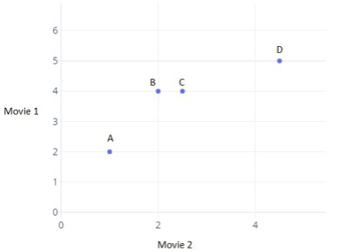
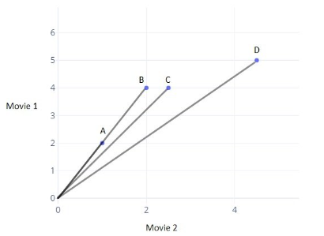
Finding similar users on the basis of rating
We plot the rating of two movies given by the user
Different distance metric can be used
Euclidian, cosine

Slide 13
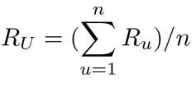
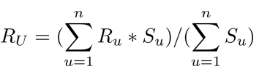
How to calculate ratings
Users rating R for an item I will be close to the average of the ratings given to I by the top 5 or top 10 users most similar to U
The formula shows the average rating given by the n similar users is equal to the sum of the ratings given by them divided by the number of similar users
When n number of users are not similarly similar – an weighted average approach is taken
The similarity factor (weights) is the inverse of the distance metric

Slide 14
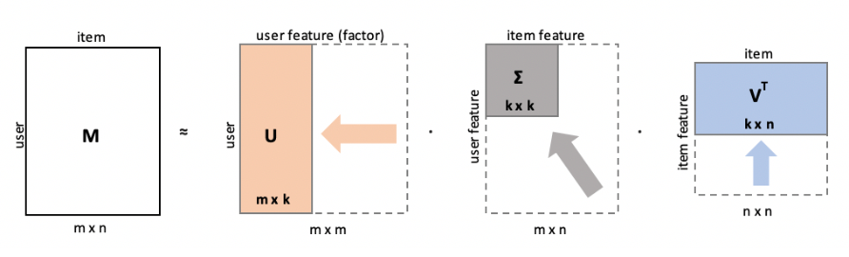
Model based - SVD

Slide 15
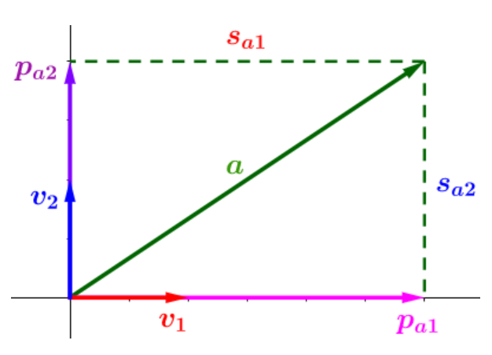
SVD
Orthogonal decomposition of vector
When the vector (a) is decomposed, we get 3 pieces of information:
The directions of projection — the unit vectors (v₁ and v₂)
The lengths of projection (the line segments sₐ₁ and sₐ₂)
The vectors of projection (pₐ₁ and pₐ₂)

Slide 16
SVD – contd..
Direction of projection represent the direction onto which we project or decompose – in the example they are X and Y axes
The lengths of projections indicates how much of the vector is contained in each direction (sa1 > sa2)
The vector of projection are used to reconstruct the o vector by adding them together. pa1 = sa1 * v1 and pa2 = sa2*v2. So this part is redundant as we can use first two to reconstruct the vector
So we observe that any vector can be decomposed into
Projection direction unit vectors (v1, v2,..)
Length of projections onto them (sa1, sa2,..)
When we extend this observation to more then one vector and to all dimension then we get SVD

Slide 17
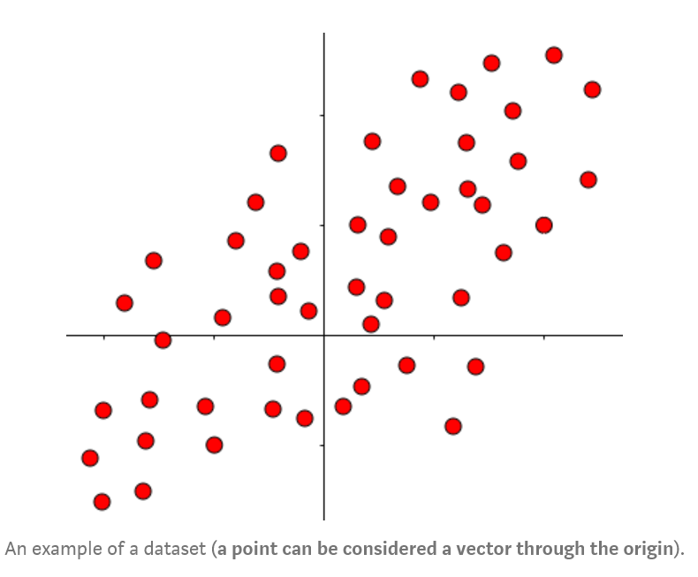
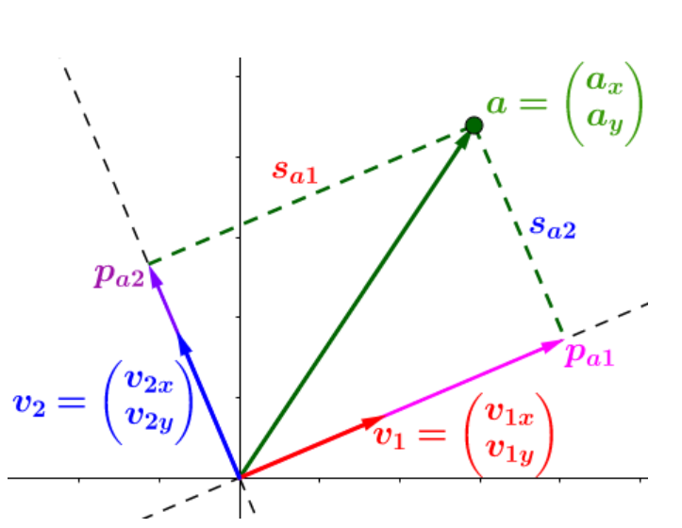
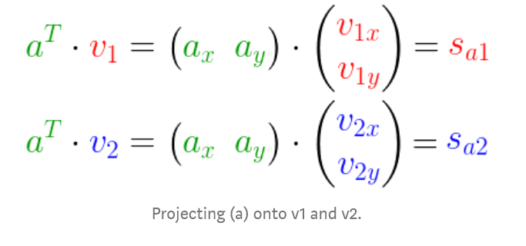
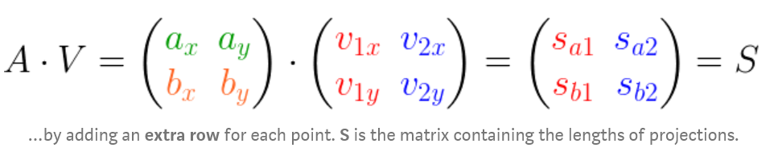
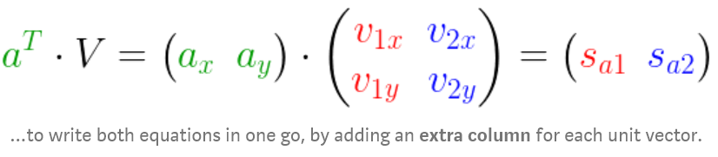
SVD – contd..
The length of the projection can be obtained using dot product
A different orthogonal axes is considered this time

Slide 18
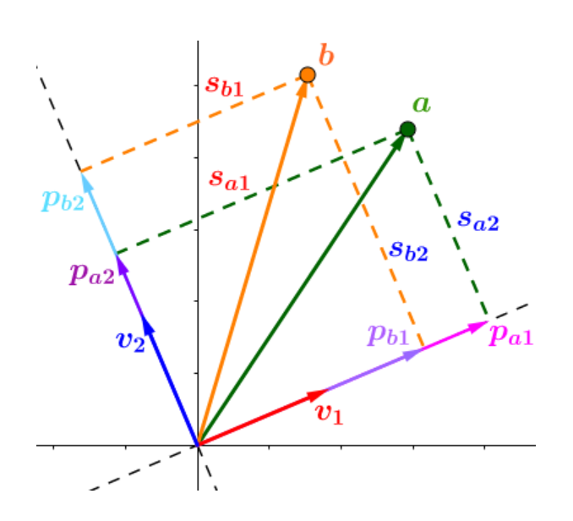
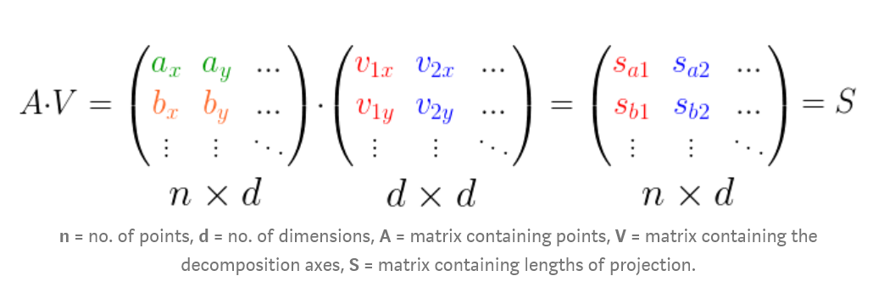

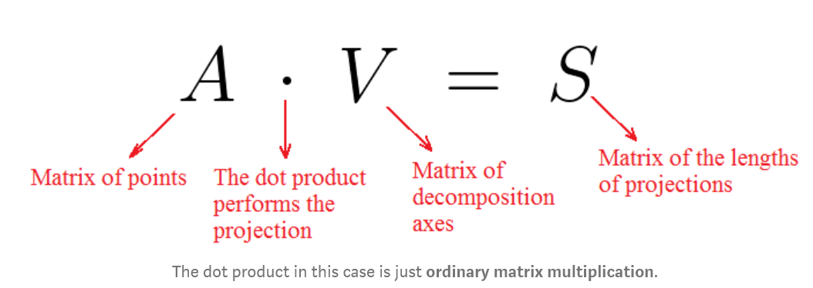
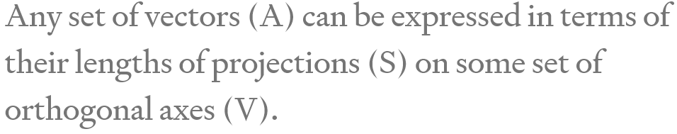
SVD – contd..
Adding one more point

Slide 19
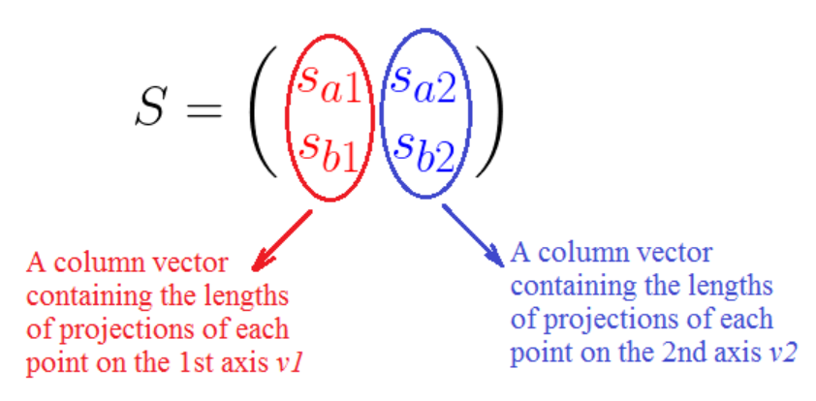
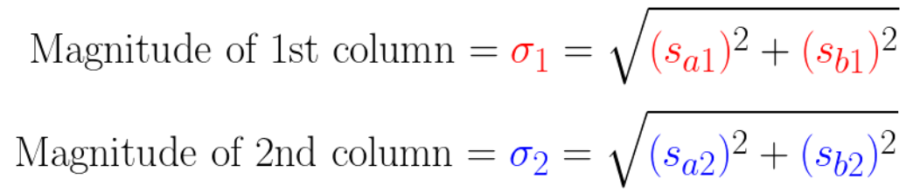
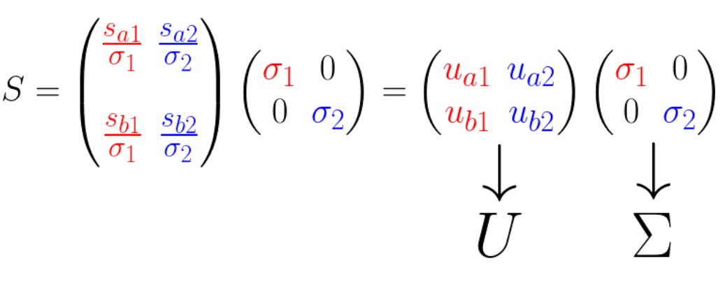
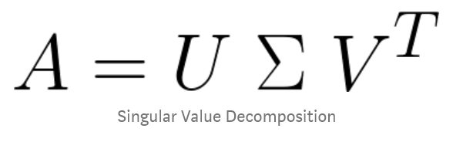
SVD – contd..
We can now normalize the column vectors

Slide 20
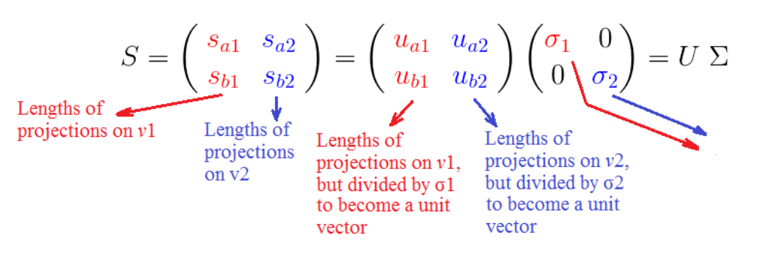
SVD contd..
We’ve already seen that (σᵢ) is the square root of the sum of squared projection lengths, of all points, onto the ith unit vector vᵢ.
they represent how close all the points are to that axis.
E.g. if σ₁ > σ₂, then most points are closer to v₁ than v₂, and vice versa.
This is the most important outcome of SVD

Slide 21
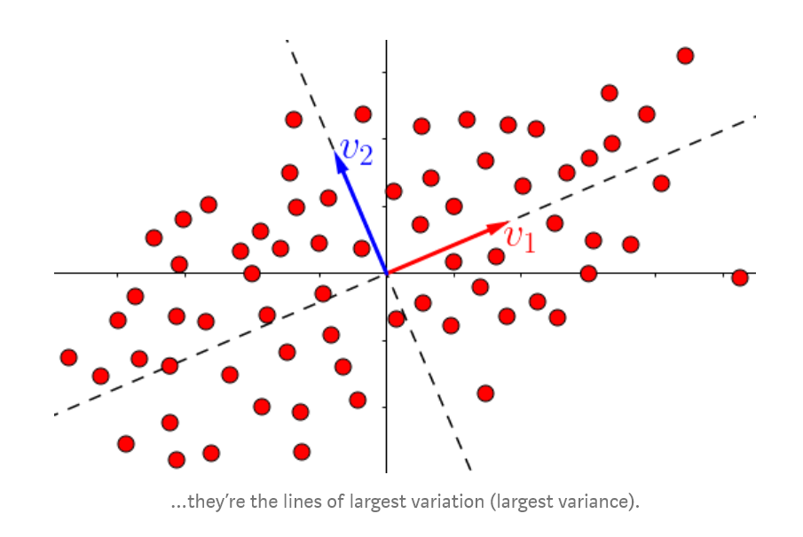
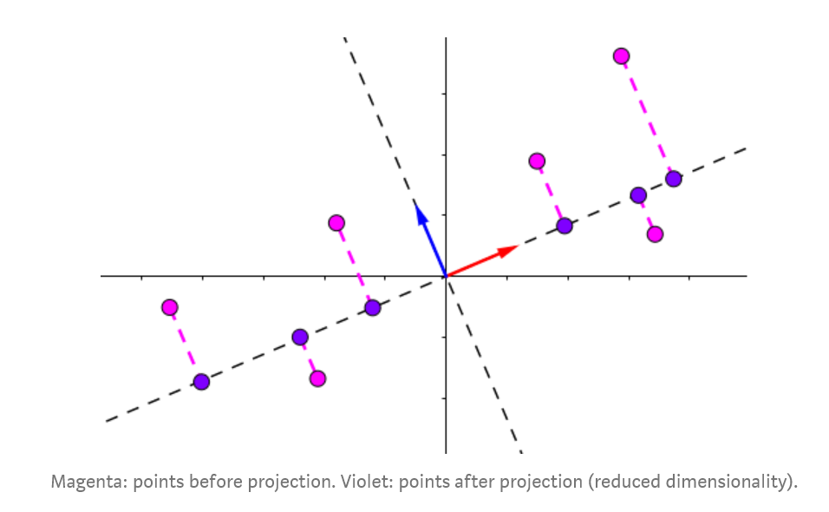
SVD contd..
How are the projection directions chosen?
They are the principal component of the data matrix

